Slide 1

BlackJack Game
Group 2

Slide 2
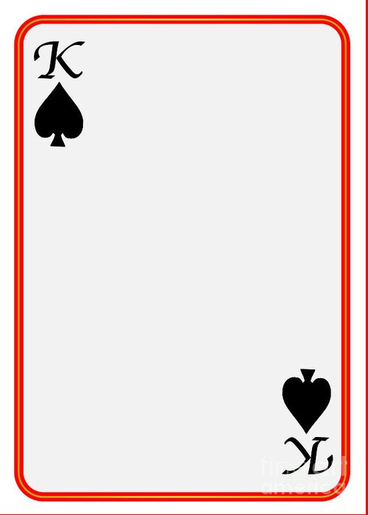
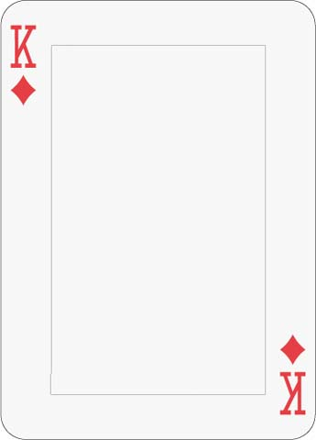
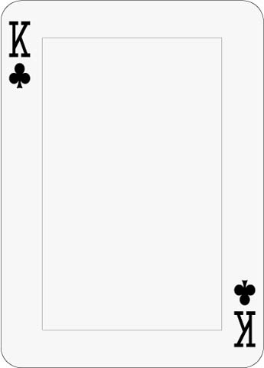
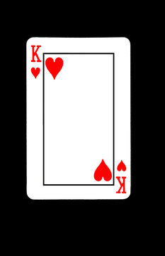
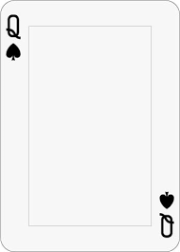


Cristian Gonzales
Armand Tirado
Brandon Wall
Kenny Yu
Mahlet Bekele

Slide 3

Project Topic
Multiplayer Blackjack
The multiplayer Blackjack gaming system is a Java-based application with a GUI, bringing users closer to a peak gaming. Real players will be able to log on and join virtual tables, place bets, win big, and play under standard blackjack rules. It operates over TCP/IP, ensuring real-time gameplay, fund transactions, fair play, and minimal cheating.

Slide 4
Requirements for the project
User Dashboard
The system must display a unique dashboard for dealers and a unique dashboard for players.
Player Fund Management
The system shall allow users to deposit funds into their account so that they can play games. Users should also be able to withdraw funds from their account.

Slide 5
Requirements for the project
3. Cheating is minimized
Use a blackjack “shoe,” which combines 3 decks of cards together to make it harder to know what is left in the deck. Also reshuffle the deck when it is halfway empty to minimize players understanding of what is left in the deck.
4. Game lobbies
Dealers will have the ability to create a new table. Players will have the ability to view active game tables and join an open table as long as a dealer is present.

Slide 6
Requirements for the project
5. Fair play
All participants must have an equal and impartial gaming experience, and the game logic must adhere to normal blackjack regulations. Dealing of cards ought to be random and unaffected by player action.
6. Betting Management
Players will have the ability during their turn to place bets with their available funds. The game payouts will be distributed after winners are determined for each game.

Slide 7
Requirements for the project
7. Game room player limit
For a game to start, there must be at least one player and exactly one dealer, with a maximum of six players.
8. Valid table entry checks
Players can only join tables if they have available funds in their account and the table they are trying to join has less than 6 players and a dealer present.

Slide 8
Requirements for the project
9. Game Management
Controls the flow of the game, including keeping track of which player's turn is taking place actively.
10. Network loss
If a player loses connection, they will be dropped from the game.

Slide 9
Requirements for the project
11. Opting out of a game
Players have the chance to forfeit the game but also their bet. This option must appear in the same menu where you would find; hit, stand, double down, and split.
12. Stand in a game
Other options players have mid-game is to “stand” or not receive any more cards. The player can “double down” or double their bet and receive yet another card after their initial hit. They can also “split” if the player has 2 of the same card value in hand.

Slide 10
Top 5 Class Candidates
Lobby
Contains the list of available tables that the player can connect to. The dealer can also make tables here.
Table
Contains the list of players, the deck, and controls the flow of the game
Player
A representation of a person logged into the game. Can add/withdraw money and join tables to play blackjack. Dealer is a child class of player that can also make tables.

Slide 11
Top 5 Class Candidates
Deck
Contains cards to be dealt out. Can be shuffled and reset as needed. Generates 52 unique cards. As a shoe, it can generate 3 sets of decks.
Card
An instance of a playing card. Contains a number/value and a suit. Generated by the deck and can be passed to dealers and players during the game.

Slide 12
Project Timeline
2/6/2025 Project Presentation project.init()
3/6/2025 Project Presentation (Phase 1 Requirements)
4/10/2025 Project Presentation (Phase 2 Design)
4/17/2025 Project Presentation (Phase 3 Implementation)
4/24/2025 Project Presentation (Phase 3 Testing)
5/1/2025 Project Presentation (Phase 3 Maintenance)

Slide 13
